Slide 1

Reduction of the Under-Five Mortality Rate in the Empowered Action Group
Divya Alukal
DATA 695: Capstone
Dr. Deanne Larson
March 21, 2023
Notes:
Thank you all for being here. Today, I am going to walk you through the work I did to create a predictive model for the Under-Five Mortality Rate, or U5MR, in the eight Empowered Action Group states and Assam.

Slide 2
Healthcare Disparities and U5MR
High inequality in India
Decentralized decision making exacerbates this.
The effects of healthcare inequality can be seen among all age groups, but especially in the high rate of children who die before their fifth birthday, the Under-Five Mortality Rate.
Notes:
The truth is that India is a highly unequal country. Decentralized decision making which can differ even between districts makes this worse. This comes to light in the area of healthcare, in which the treatment someone is afforded depends on their financial status, class, caste and location, among other things. There is an extremely high Under-Five Mortality Rate, which measures how many children die before their fifth birthday out of 1,000 live births.
-----------------------------------------------------
The truth is that India is a highly unequal country: This comes to light in the area of healthcare, in which the treatment someone is afforded depends on their financial status, class, caste and location, among other things.
Decentralized decision making which can differ even between districts makes this worse. For example, rural areas have assigned Chief Medical and Health Officers, and urban areas have Principal Medical Officers, who are responsible for planning for their districts, implementing policy and programs, and more. This can lead to great variation in medical and health care across different places, not to mention that corruption can prevent citizens from getting the care they need – for example, if medical workers demand bribes in exchange for care at facilities that are supposed to be free, or if a doctor never shows up for work or if a hospital is not provided with the items it needs to properly take care of people.
India is a country with a growing and very young population, having a median age of 28.4. Nonetheless, there is an extremely high Under-Five Mortality Rate, which measures how many children die before their fifth birthday out of 1,000 live births.

Slide 3
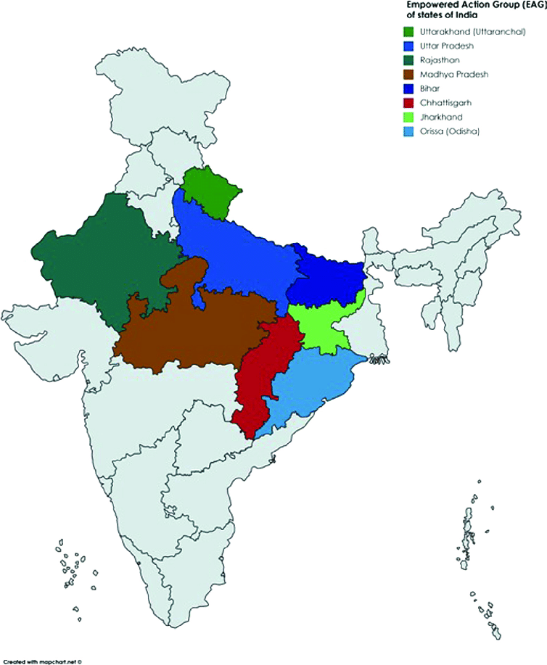

Empowered Action Group (EAG)
Eight socioeconomically deficient states with the highest U5MR in India
Annual Health Survey (AHS) administered in EAG states and Assam
Notes:
This project is based on data from the Annual Health Survey which was administered in nine socioeconomically backward Indian states.
----------------------------------------------------------------------------------------------
Much of India’s U5MR, which accounts for about one-fifth of the world’s total, can be attributed to the eight states of the Empowered Action Group (EAG). The Ministry of Health and Family Welfare of India established the EAG in 2001; these eight states account for about half of the country’s population and are socioeconomically deficient compared to the country overall. In 2016 the United Nations adopted 17 Sustainable Development Goals to achieve by 2030. The third goal focuses on ensuring healthy lives and promoting wellbeing. In order to achieve this, it is imperative that India reduce its U5MR.
The Annual Health Survey was administered three times between July 2010 and May 2013 in EAG states and Assam, which together contribute about 70% of under-five deaths in India. It is a comprehensive survey investigating many variables pertaining to demographics, health, social indicators and more in every district of these nine states.

Slide 4
Task
To create a model that will predict the U5MR for a district based on demographic, social and health information
To identify the factors most relevant to U5MR that the government should take action on
Notes:
My task was to create a model that will predict the U5MR for a district and to identify the factors most relevant to U5MR
--------------------------------------------------------------
My task was twofold:
To create a model that will predict the U5MR for a district based on demographic, social and health information
To identify the factors most relevant to U5MR that the government should take action on

Slide 5
Method
Dataset: survey data from 2012-2013 iteration of three-year Annual Health Survey
  Challenges
    Low sample size – 284
    High number of features – 643
      Three- and nine-fold variants
Data mining through coding language Python
Data exploration -> Model creation -> Model evaluation -> Final selection
No anticipated ethics or data security issues
Notes:
In order to do this, I used survey data from the 2012-2013 iteration of the AHS, which covers each district of the nine states with a 98% response rate.
There were two main challenges posed by the dataset.
Its sample size was 284, one for each district, which is very low. Ideally would have thousands more to give more information to the predictive model.
High number of features (variables) – it would have been prohibitively many to run in a model and many variables would have been a waste of space in the model, not contributing enough useful information to justify their inclusion – although, presumably, all the data collected through the survey was at least tangentially related to the target variable of U5MR
Additionally, many variables were split by gender (male-female) and/or location (urban-rural), in addition to the basic total variables. This made for three or sometimes even nine version of the same basic variable, many of which I would not include.
#I knew I had to cut down the number of original variables into a subset I could use to create the predictive models.
#I completed this process using the coding language Python. The general process was to explore and preliminarily analyse the data, then create multiple predictive models of different types, then evaluate them and finally choose one which I will recommend to you today.
#There are no anticipated ethics or data security issues – some features would potentially be sensitive if the individuals who endorsed them had been identified. However, all data was aggregated at the district level, so there is no chance of any individual or family being identified or linked with any particular attribute.

Slide 6
Exploratory Data Analysis
Notes:
I will now discuss the process of exploratory data analysis with which I began the project.

Slide 7
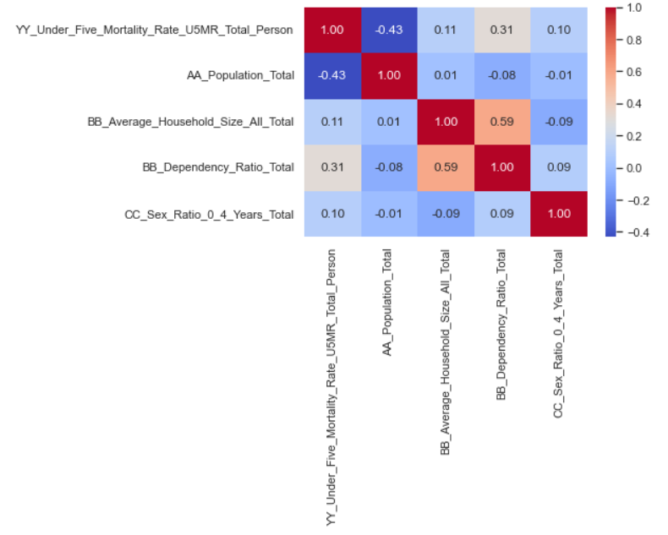
Correlation Matrices for Feature Selection
Notes:
As mentioned earlier, there was an enormous number of features in the dataset. I knew that I could not use them all, nor would it make sense to.
I began by creating correlation matrices of variables that I felt would be most relevant to U5MR, as many as I identified that did not have duplicative information. These tables show the correlation, or dependence as a decimal out of 1.0 between different variables. The variables which show a greater absolute value, that is, the value with negative signs removed, aligned with the target variable, will be of greater importance in studying it. So, here we can trace YY_Under_Five_Mortality_Rate_U5MR_Total_Person, and we see that the two features which have the greatest correlation with it are AA_Population_Total, with an absolute value of 0.43, and BB_Dependency_Ratio, with an absolute value of 0.31. These were sufficiently high to be included in the feature subset that I used for modelling; I disregarded the other two. At the end of this, I had 14 variables in the subset, which would increase with the next step.
--------------------------------------------------------------------------------------------------
As mentioned earlier, there was an enormous number of features in the dataset. I knew that I could not use them all, nor would it make sense to. I began by using my subject matter knowledge to make two tiered lists of variables; one which I felt was very likely to be related to U5MR, and one which was not quite as likely. The majority of the features, however, did not make it to either list at all.
After this, I began by creating correlation matrices of variables from the first tiered list and the target variable, U5MR. These tables show the correlation, or dependence as a decimal out of 1.0 between different variables. The variables which show a greater absolute value, that is, the value with negative signs removed, aligned with the target variable, will be of greater importance in studying it. So, here we can trace YY_Under_Five_Mortality_Rate_U5MR_Total_Person, and we see that the two features which have the greatest correlation with it are AA_Population_Total, with an absolute value of 0.43, and BB_Dependency_Ratio, with an absolute value of 0.31. These were sufficiently high to be included in the feature subset that I used for modelling; I disregarded the other two.
I did not end up using all the variables from the first tiered list, although I made correlation matrices for as many as I could that did not have duplicative information. I did not use any features from the second tiered list. Nonetheless, at the end of this, I had 14 variables in the subset, which would increase with the next step.

Slide 8
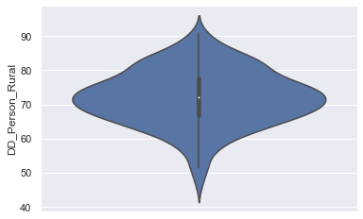
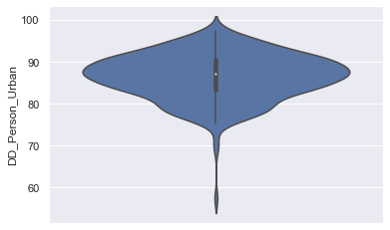
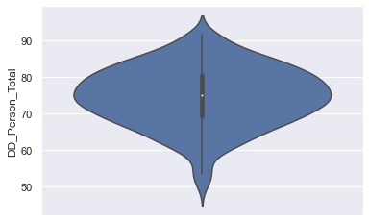
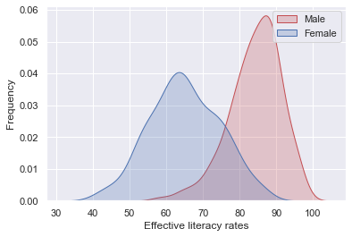
Data Visualization to Select Variants
Notes:
As stated before, many of the features in the original dataset came in variants. I did not want to include any variants unnecessarily nor exclude them when they would have contributed useful information to the model. Therefore, for the 14 variables I had identified, if I deemed the variants possibly worth exploring, I used data visualization to depict their distributions, that is, how many samples had a certain value. For example, we see from the violin charts in the top row that there were clear differences in distribution of rural and urban literacy rates, and a difference in male and female literacy rates from the density plot below. Since these seemed relevant to the target variable, I elected to include all these variants in the feature subset.
-------------------------------------------------------------------------------------------------------------------------
As stated before, many of the features in the original dataset came in variants. I did not want to include any variants unnecessarily nor exclude them when they would have contributed useful information to the model. Therefore, for the 14 variables I had identified, if I deemed the variants possibly worth exploring, I used data visualization to depict their distributions, that is, how many samples had a certain value.
Above, we see violin charts showing locational distribution of effective literacy rate. It is not divided by gender. On the left there is rural, in the center is urban and on the right is the basic feature. Rural areas seem to have a more equal distribution, with the lowest values slightly above 40% and the highest over 90%, but most values concentrated in the middle. The maximum and minimum values for urban areas are higher than those of rural areas, and moreover, the lower values are very few in comparison to the higher ones. Therefore, there seems to be a clear locational divide, so it would be worthwhile to include both the rural and urban variants in addition to the basic one.
Below, we see a density plot showing male and female effective literacy rates. It is evident that male literacy is much higher, with rates typically falling between 80-90% while female rates typically fall between 60-70%. Again, this showed that both variants were worth including, as the gender differences may lead to understanding U5MR.

Slide 9
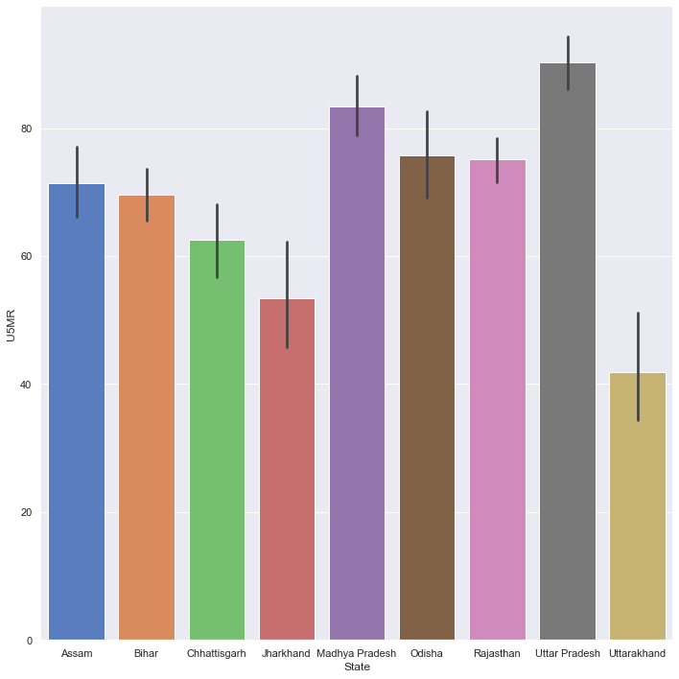
Does State Matter?
Notes:
We know that healthcare decision making is highly decentralized even to the district level. However, there are likely some things that unite each state, like policies or programs. In order to see if state is an important factor in U5MR, I created a bar chart showing the average rate per state. As we can see, there is a difference of close to 5% between the state with the highest and lowest rates, with the highest being around 90 deaths per 1,000 live births, and the lowest being around 41 deaths per 1,000 live births. This difference made it clear that state does play some role in the U5MR. Therefore, I included that feature in my analysis. This led to 32 variables total in the feature subset.

Slide 10
Model Development
Notes:
Having prepared the feature subset, which I will hereafter refer to as the dataset, I began creating models.
I split the dataset into two parts: a training set with 198 samples which would be used to generate models, and a smaller test one with 45 samples that would be used to evaluate the models and ensure that they worked well for data that had not been used to create them. The target variable, the Under-Five Mortality Rate, was split off so as to be kept separate from the predictor variables which would be used in creating the models.
I initially tried seven different model types, or methods that could be used for the regression. For each of these seven regressors, I used 10-fold cross-validation to fit the regressor to the training predictor data. This means that I made the regressor learn the patterns in the data and the type of target value that accompanied these patterns for each sample through a series of ten iterations. I then used the fitted models to predict target values for the test subset of samples based on what their other feature values were. The purpose of this was to gain an estimate of which regressors would generally be best to take forward; however, this step would be repeated later once the models had been modified with better conditions.
Based on a metric called explained variance that measured the amount of variation in U5MR that can be attributed to the predictor variables, I chose four model types with which to continue.

Slide 11
Selected Regressors
Linear regression - a relatively simple method that creates a line that will minimize the distance from samples in order to predict a continuous target
Ridge regression - a method of regularization used to combat overfitting by shrinking data coefficients; it can make them approach, but not become, 0
Gradient boosting regressor - a model that adds multiple simple decision trees (like flowcharts), one at a time, strengthening the predictions
Random forest regressor - fits multiple decision trees onto the dataset or a subset of the dataset at once and averages their predictions
Notes:
These are the four model types, or regressors, I chose based on having the highest explained variance.
[JUST SAY NAMES AND BRIEF SUMMARY]
[Read first two]
These two involve using all features to create a predictive line with as little distance from all data points as possible.
[Read last two]
The last two involve averaging the results of multiple decision trees, which function like flowcharts that redirect the prediction for a given sample downward based on its values for various features.

Slide 12
Training Models
Grid search to find hyperparameters
Fit models to training data
Predict training and test subset target values
Notes:
Having chosen the four regressors to use, it was time to train them. Again, this means learning the patterns in the data and what predictor values typically accompany a certain value of the target variable.
I used an exhaustive grid search to find something called hyperparameters. These optimize the models by making them learn the data better compared to the default hyperparameters.
Then, I equipped each model with the ideal hyperparameters and once more fit them with the training data. This time, I used the model to make a prediction of what the values would be for both the larger training set and the smaller test set. To reiterate, this differs from the first time I did this because at that time, I used the default hyperparameters for the models and only predicted values of the test subset to get a general picture of how well those particular model types would work.

Slide 13
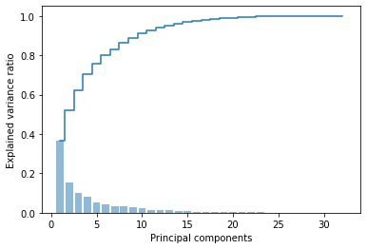
Principal Component Analysis (PCA)
Ideal for problems with many features
Extra version of each model
Here, six components
Predict training and test subset target values
Notes:
There is a process called Principal Component Analysis, or PCA. It is very useful for problems that have a lot of features because it compresses all of the information they hold into new variables called principal components. However, some principal components will hold more information that explains variation in the target variable than others do. Therefore, just a few of these components can be very powerful in a model where having too many variables could be overwhelming and obscure information.
I decided to make a version with PCA of each of the four chosen model types, making for eight models in total. I used the same hyperparameters but had to fit the model to the training data and predict training and test values of U5MR again. However, this time, the training data was different. As we can see in the chart here, just the first six largest of the 32 principal components encapsulate about 80% of the information. Obviously, this leaves out 1/5, but it is still very good for such a small number. Therefore, I decided to make the cutoff at six components, which became the training data for the PCA models.

Slide 14
Model Evaluation
Notes:
Now, I will discuss the ways in which I evaluated the models to determine which would ultimately be the best one or ones to use. This involved using certain numerical metrics and data visualizations.

Slide 15
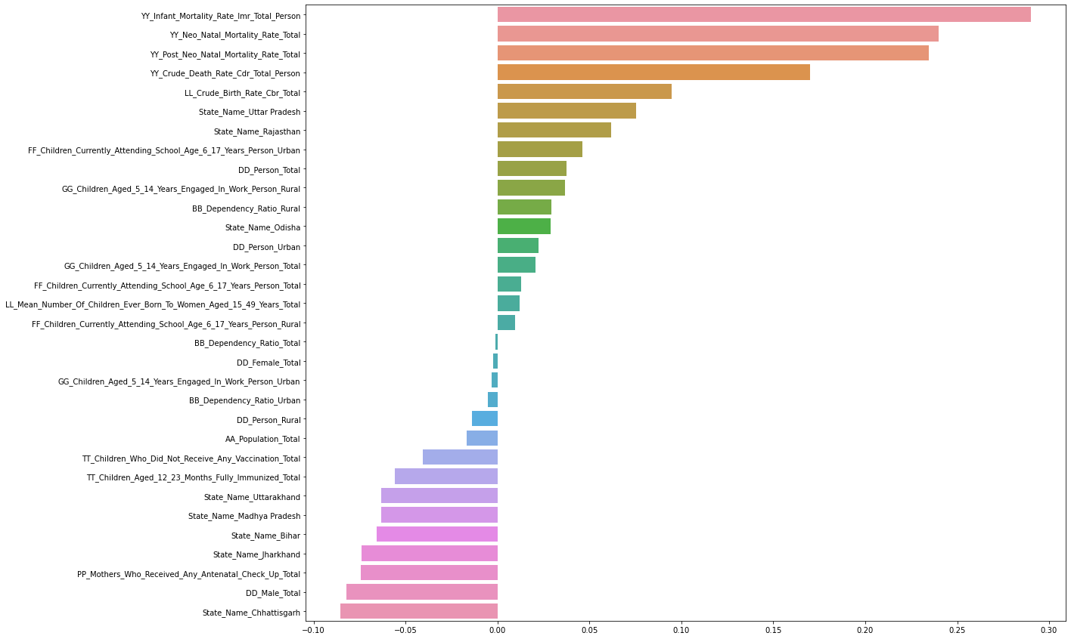
Coefficients
Notes:
Here, we see an example of a bar chart showing feature coefficients for the non-PCA Ridge Regression model . Coefficients quantify the amount of influence each variable has on the prediction, so the larger the absolute value of the coefficient, the greater its impact. I examined coefficients for the Linear regression and Ridge Regression models.
Here we can see, unsurprisingly, that the four variables from the dataset which were also closely related to mortality and death have the greatest impact on the U5MR prediction; the greater their values, the greater U5MR prediction will be as well. On the other hand, looking towards the bottom of the chart, we see that as male literacy decreases, U5MR increases, which is signified by the negative coefficient. I would like to point out that this is an example of how correlation does not necessarily equal causation; we need to use our subject matter knowledge to make that distinction. Infant Mortality does not truly cause Under-Five Mortality; the causes of one are also the causes of the other.
The coefficients for this model, which was the best performing one, indicate that a mix of features related to birth rate, state, education and healthcare are the most influential in this model’s predictions of U5MR.

Slide 16
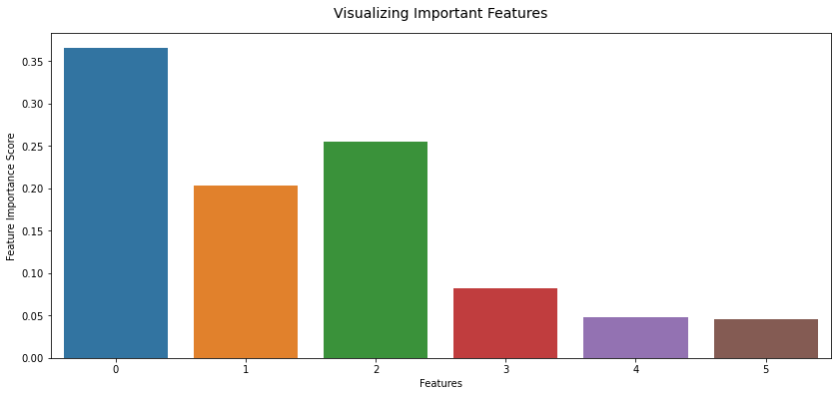
Feature Importance
Notes:
Feature importance is something similar to coefficients that also shows the amount of effect that variables have on the predictive model. I this examined for the Gradient Boosting Regressor and Random Forest Regressor models. This is a bar chart of feature importance for one of the PCA models, and we can see that it shows bars for the six principal components.
#One problem with interpreting principal components is that, because each is composed of information from multiple dataset variables, we need to examine coefficients associated with them called eigenvectors that provide their composition from the original variables. Had this particular model, which is for PCA Random Forest Regressor, had better evaluation metrics, I would have examined the eigenvectors in detail to find the most associated variables.

Slide 17
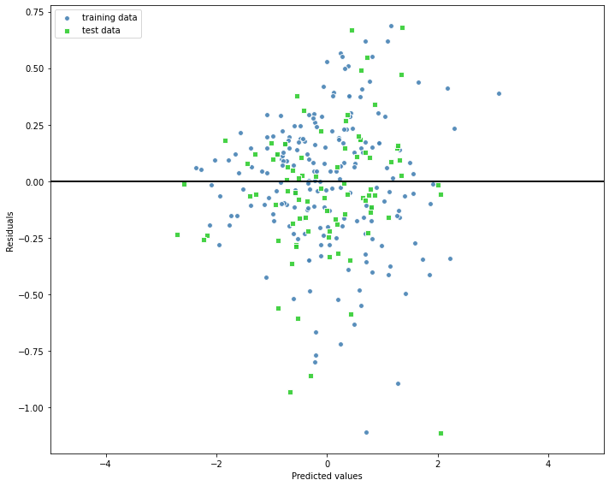
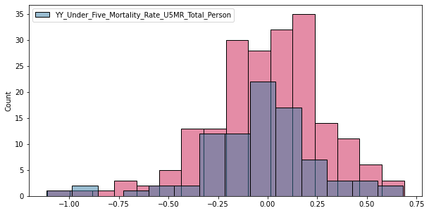
Evaluation Metrics - Error
Coefficient of determination (R²)
Mean Standard Error (MSE)
Notes:
Now, I will discuss the two main quantitative evaluation metrics that I utilized for each model. One is called the coefficient of determination, which one may see written as R². It is somewhat similar to explained variance and indicates how much variation in the target variable can be predicted from the predictor variables. The other metric is called Mean Standard Error (MSE), which compares the predicted and actual values of the target variable to see how well the model fits the data. MSE penalizes larger errors because it squares them.
Ideally, we want R² to be as high as possible (within 1.0) and MSE to be as low as possible. However, it is also desirable that the model performs equally well or better with the test data than with the training data. This is because we want to be sure that the model we create is not so closely tailored to the training data that it cannot accurately predict values for new data that it was not trained on – otherwise, the model would be of no use. For this reason, it is preferable that R² be higher and MSE be lower for the test predictions than for the training predictions. This is what I looked for while evaluating each model.
Here, we see two ways in which I visualized each model’s error.
On the left, the bar chart shows counts of samples [which are districts] for each amount of difference between predicted and actual values of the target variable. We can see that the differences are mostly low, centered around 0, which is good. This speaks to higher accuracy of the model.
On the right, we see a residual plot which shows the error for each sample in the training and test sets. In a residual plot, we want to see two things:
Concentration of points near the black horizontal line
No bias or patterns.
This chart fulfills the second point, but not the first, which indicates that the model type may be appropriate, but some of the samples had large errors.

Slide 18
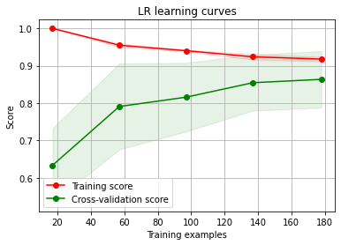
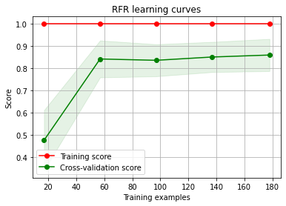
Evaluating Fit with Learning Curves
Notes:
Learning curves are a means of assessing how well a model fits the data and whether a model would benefit from adding more samples.
If the lines for the training and test scores approach each other as more samples are added, this means that the model is able to generalize to new data and is not only suitable for the training data. Also, if they continue to approach each other by the end of the chart, this can indicate that the model would continue to become stronger with the addition of more samples.
The chart on the left, which was for non-PCA linear regression, shows the two lines continuing to approach each other. This means that the model is good and more samples could help it to train even better. The chart on the right, which was for non-PCA random forest regressor, shows the training score at 100% throughout, while the test score practically levels off by the end. They are very far away from each other, an indicator of the high error rate that the random forest regressor models had, and adding more samples likely would not improve the model.

Slide 19
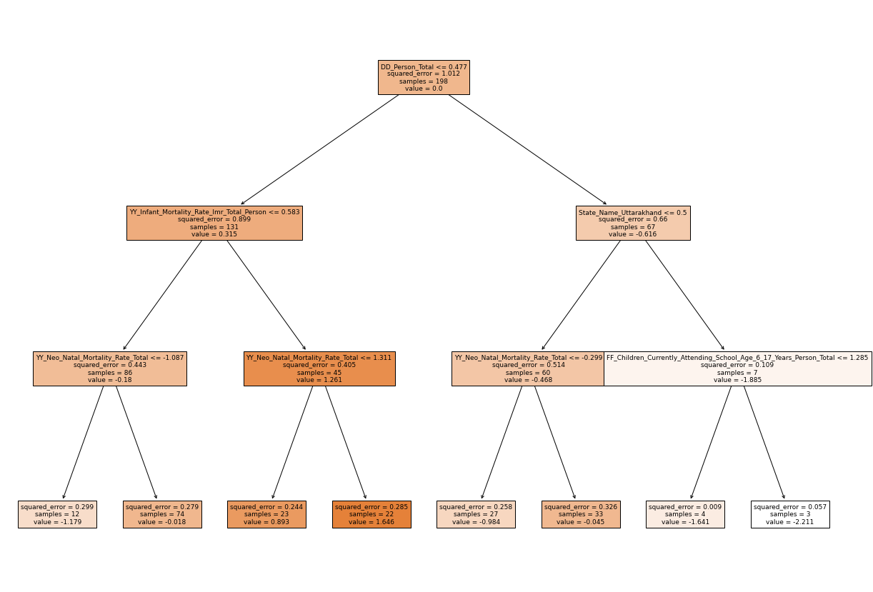
Decision Tree for Representation
Notes:
Finally, I would like to show an example of a decision tree for your perusal. This is not a tree from one of the models I intended to be used for this project, although I did use the same dataset for it. The trees created for those models were too large to be shown here. However, I would like to briefly show you what such a tree looks like and how it works. We can see that it functions like a flowchart. At each node, a predictor variable is named with a value and if a sample has a value less than or equal to that, it will proceed downward to one side, or to the other side if its value is greater. For this tree, which has three levels, there are eight possible final predictions for U5MR that can be made. The trees from the real models I generated were much larger and had dozens of possible target values each. However, we must consider that concrete pre-determined values like this may not be appropriate for a dataset with such varying features and values. This may explain why the two tree-based model types, gradient boosting regressor and random forest regressor, performed so poorly.

Slide 20
Conclusions
Notes:
Now, I would like to speak about the conclusions I gathered from this project and steps going forward.

Slide 21
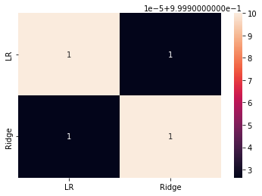
Model Choice
Worst: PCA Random Forest Regressor
Best: Ridge Regression, followed by Linear Regression
Final model: Voting ensemble
  Strengthens predictions by averaging
Notes:
Based on the evaluation metrics, the worst model was the PCA Random Forest regressor, and in fact, each PCA model performed worse than its non-PCA counterpart.
The best model was the non-PCA Ridge Regression model, followed by the non-PCA Linear Regression model. I created a correlation matrix of the two models’ predictions which showed that there was a 100% match in the predictions they made for the test data. For this reason, I elected to create a voting ensemble which averages the predictions made by these two individual models. In case of any discrepancies on new data, having two contributing models would strengthen the final prediction better than relying on one model. This is the predictive model that I recommend using to predict the Under-Five Mortality Rate in the nine Annual Health Survey states.

Slide 22
Most Influential Features
Coefficients of top models indicate features such as:
  Literacy rate
  Children attending school
  Children engaged in work
  Antenatal care
  Children’s immunization
  Dependency ratio
  Birth rate
  State
Notes:
As we saw earlier, the coefficients of the best two models indicated a multitude of areas which affect U5MR. Thus, it is clear that not only healthcare and medical disparities, but also a variety of other factors impact U5MR, and all must be addressed.
---------------------------------------------------------------
As we saw earlier, the coefficients of the best two models indicated a multitude of areas which affect U5MR. These include:
[READ THEM OFF THE SLIDE].
Thus, it is clear that not only healthcare and medical disparities, but also a variety of other factors impact U5MR, and all must be addressed.

Slide 23
Next Steps
Implement policies to address key areas
  Legislation, programs, schemes
  Eradicate corruption
  Invest in infrastructure like roads, hospitals, schools
More centralized decisions for unity across states
  Follow example of other states
  Avoid politics, prioritize people
Notes:
I suggest that policies be implemented to address these key areas. I also suggest, based on the differences in outcomes by state, that there be more centralized decisions for unity across the states.
-----------------------------------------------------------------------------------
I suggest that policies be implemented to address these key areas. This may come in the form of legislation, programs, government schemes, and more. It is imperative to increase literacy for people of all ages, reduce child labor, ensure prenatal care, and more. We know that every institution in our country is plagued with corruption. This issue is, in fact, an enormous contributor to U5MR and must be eradicated. We must invest in infrastructure like roads, hospitals and schools which are essential to improving these factors.
I also suggest, based on the differences in outcomes by state, that there be more centralized decisions for unity across the states. They may consider following the examples of other states with better programs/outcomes. In this, we must remember to avoid politics and prioritize people. Decisions should not be made simply to make one party look good, but rather to improve people’s lives.

Slide 24
Going Forward
Improve model
  Refined feature subset selection
  Inclusion of validation subset
  Impose limits on outlying values
  Augment sample size
  Increase number of principal components
U5MR stems from much more than healthcare inequity
Use of this model will provide
  Expected U5MR values
  Most influential features
Notes:
Going forward, there are several ways in which this model could be further improved. Once again, we note that the causes of U5MR are multifarious and need to be addressed holistically. Using this model that I have created will provide not only a means to predict expected U5MR values based on predictors, but also the most influential features that must be addressed.
--------------------------------------------------------------------------------
Going forward, there are several ways in which this model could be further improved. These include:
Refining the feature subset so that no unnecessary or irrelevant variables are included in the models; including a validation data subset, which would be an additional way to test the fit of the model; imposing limits on extremely high or low values so that they do not overly influence the model; increasing the sample size, although this comes with challenges and is NOT to be done using data from non-AHS states; and increasing the number of principal components used so as to encapsulate more data.
Once again, we note that the causes of U5MR are multifarious and need to be addressed holistically. Using this model that I have created will provide not only a means to predict expected U5MR values based on predictors, but also the most influential features that must be addressed.

Slide 25
Questions?
Notes:
Thank you for your attention. Are there any questions?

